Slide 1
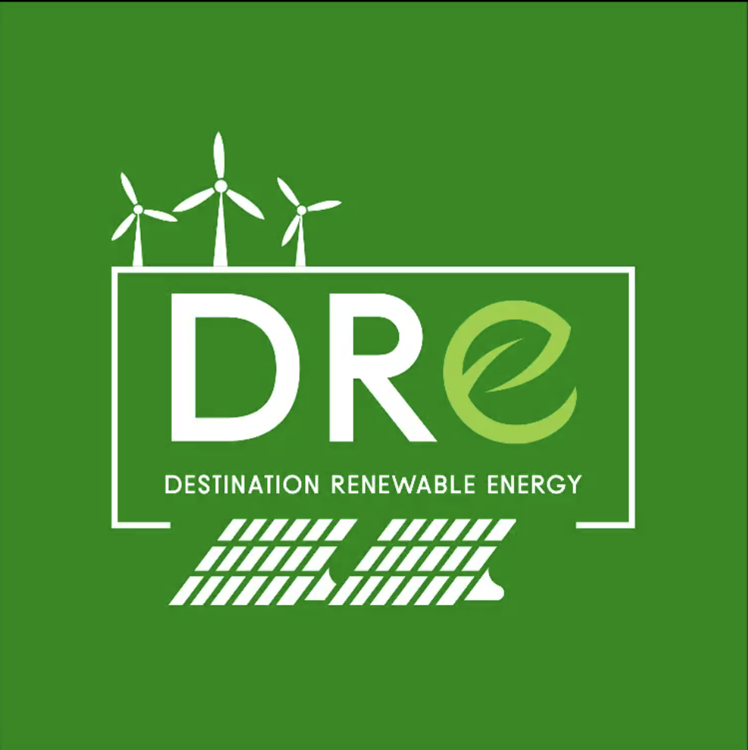
DRE Use Case
Model Overview

Slide 2
Module Overview
Purpose: The module introduces the DRE use case as part of the DestinE platform. It builds on prior knowledge to engage advanced users and strengthen the understanding of new users through targeted learning objectives.
Module Title: Destination Renewable Energy (DRE) use case.
Learning Objectives: By the end of this module, learners will be able to:
understand the purpose and structure of the DRE Use Case
login to and navigate through the DRE application
extract valuable data from DRE, including:
assessments of solar radiation, solar and wind power production
2-day solar and wind parks’ power output forecasts
interpret advanced DRE output results.

Slide 3
Module Overview
Target Audience:
Solar and wind energy production, distribution and transmission operators
Researchers
Policymakers and decision makers in the energy digital transformation sector
Public authorities
Private investors in the renewable energy sector
Earth Observation (EO) specialists interested in renewable energy applications
Prerequisites: No prior knowledge is required, however, a basic understanding of solar radiation principles and wind characteristics will be useful.
User Level: Introductory
Duration: The estimated time for the completion of the module is 30 minutes.
Certification Process: Learners will receive a certification of completion.

Slide 4
DRE Use Case
Module Overview

